Slide 1
MODULE 3
ARRAY PROCESSORS

Slide 2
SIMD Array Processor
→Synchronous array of parallel processing elements
→A single control unit (CU) broadcasts instructions which are carried out in lockstep by all the processors.
→Multiple processing elements

Slide 3
Contd…
SIMD→ An array processor which can handle single instruction on multiple data streams.
2 Basic architectural organization
Array Processors using random access memory
Associative processors using content address memory.

Slide 4
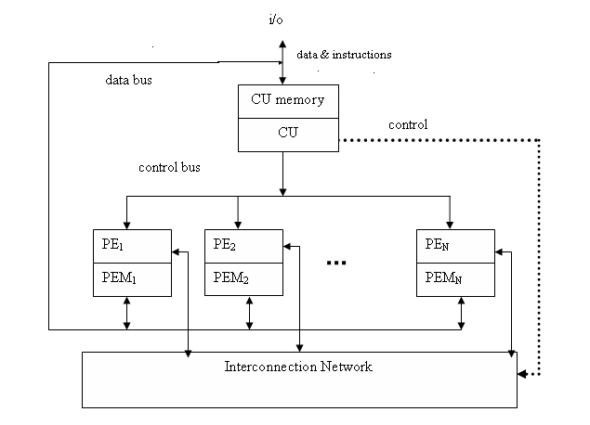
SIMD computer organization Configuration 1(Illiac-IV)

Slide 5
Configuration1 is structured with N synchronized PEs, under the control of one CU.
PEi is an ALU with attached working registers and local memory PEMi, for storage of distributed data.
CU has its main memory for the storage of programs. The system/user programs are executed under the control of CU.
User programs are loaded into the CU memory from an external source.
Function of CU is to decode instructions and determine where the decoded instructions should be executed.

Slide 6
Scalar/control type instructions are executed inside the CU.
Vector operands are distributed to the PEMs before the parallel execution in the array of PEs.
Distributed data can be loaded into the PEMs from an external source via the system data bus/ via CU in a broadcast mode using the control bus.
PEs may be either active or disabled during an instruction cycle.
Masking vector is used to control the status of PEs during the execution of a vector instruction. Only enabled PEs participate in the execution of a vector instruction.
Data exchanges among PEs are done via an inter PE communication

Slide 7
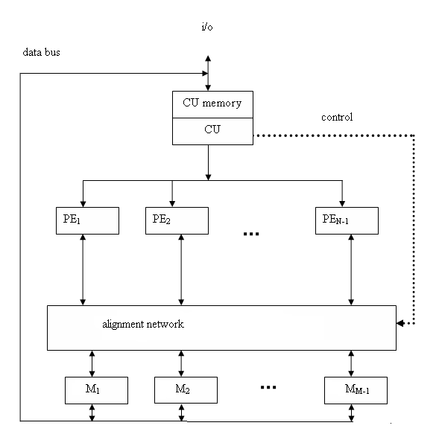
Configuration –II (BSP)

Slide 8
Difference between the configurations --in two aspects
I - local memories attached to the PEs are replaced by parallel memory modules shared by all PEs through an alignment network.
II - inter PE permutation network is replaced by the inter PE memory alignment network which is again controlled by CU.
The alignment network is path-switching network between PEs and parallel memories.

Slide 9
Formally a SIMD computer is characterized by following set of parameters.
C = <N, F, I, M>
N: no. of PEs. For eg for Illiac-IV has 64, BSP 16.
F: set of data routing functions
I: set of m/c instructions
M: the set of masking schemes, where each mask partitions the set of PEs into the 2 disjoint subsets (enabled PEs and disabled PEs).

Slide 10
Masking and data routing mechanisms
Masking schemes are used to control the status of each PE.
Each processor with its own memory, includes a set of working registries, flags, Ai, Bi, Ci and Si, logical index register Ii, address register Di, data routing register Ri.

Slide 11
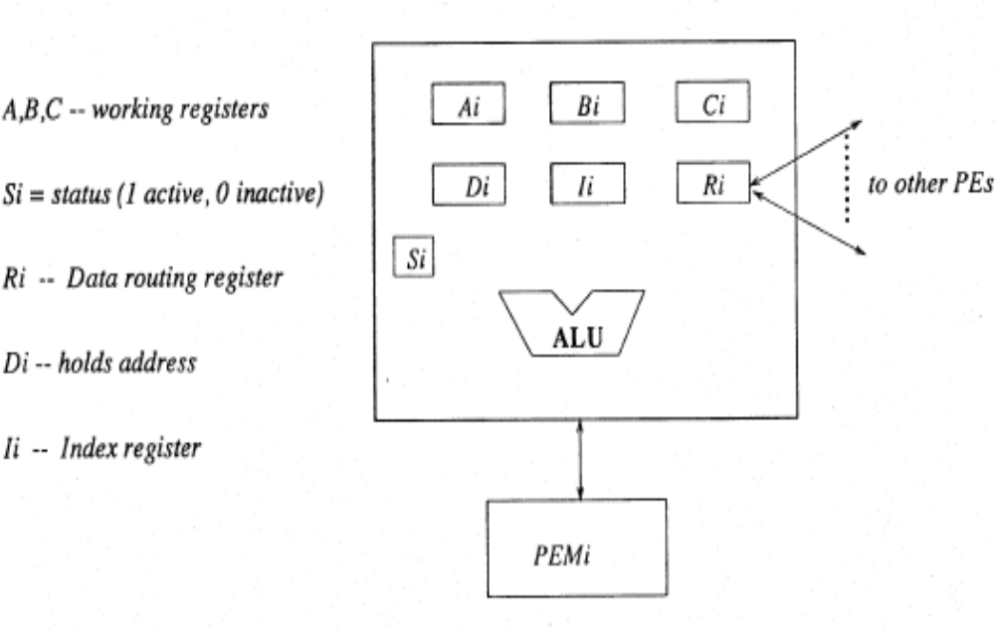
Components in a PE

Slide 12
Control Unit performs segmentation of long vector into vector loops
Distributing the vector elements in to different
PE’s
N- number of PE’s
n -number of vector elements

Slide 13
Inter PE communications
1) Operation Mode:
→The types of communication can be identified :Synchronous and asynchronous.
2) Control strategy:
→The control setting functions can be managed by a centralized controller or by individual switching element. The later strategy is called distributed control and the first strategy corresponds to centralized control.
3) Switching Methodology:
→The two major switching methodologies are circuit switching and packet switching.
4) Network topology
→The topologies can be grouped into two categories :static and dynamic.

Slide 14
SIMD INTERCONNECTION NETWORKS
Classification of Interconnection networks
Static versus dynamic network
1.Mesh-connected Illiac network,
2.Cube interconnection networks,
3.Barrel shifter and data manipulator,
4.Shuffle exchange and omega networks

Slide 15

Static Vs Dynamic Networks
The topological structure of an array processor is mainly characterized by the data routing network used in interconnecting the Processing Elements
Static networks
Topologies in static network can be classified according to the dimensions required for layout. ie one-dimensional, two-dimensional, three-dimensional
Examples for one dimensional topology :- linear array.

Slide 16
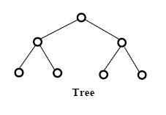
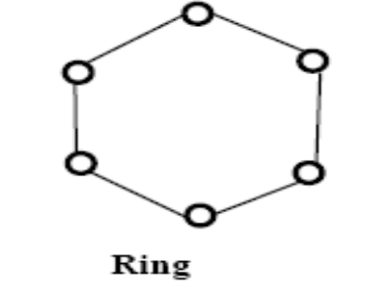
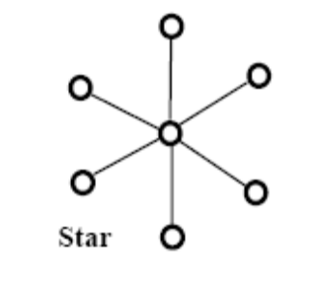
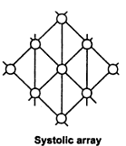
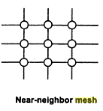
Two dimensional topology :- ring, star, tree, mesh, and systolic array.

Slide 17
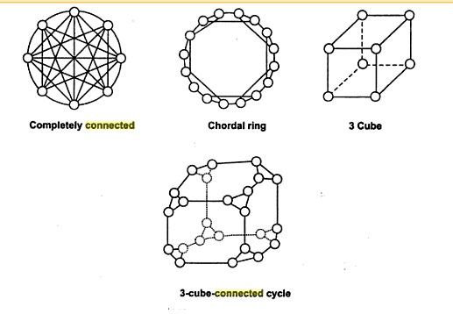
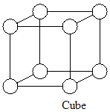
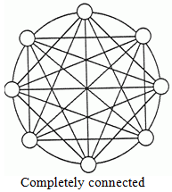
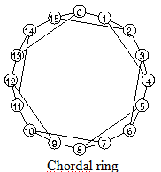
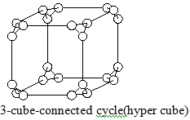
Three dimensional topologies include completely connected chordal ring, 3 cube, and 3 cube connected cycle networks (hyper cube).

Slide 18
Dynamic Networks
Single-stage Vs Multi-stage
Single-stage networks
  A switching n/w with N input selectors (IS) & N output selectors (OS)
  IS is a 1-to-D demultiplexer & OS is an M-to-1 multiplexer
  Single-stage n/w is also known as recirculating n/w
  Data items may have to recirculate through the single stage many times before reaching final destination

Slide 19
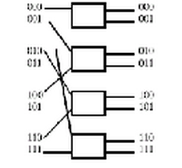
Single stage interconnection n/w

Slide 20
Multistage networks
Multistage networks are described by 3 features :
switch box, n/w topology, control structure
Switch box is an interchange device with 2 i/p & 2 o/p
Multistage networks are divided into 2
      One-sided n/w & two-sided n/w
  Two sided n/w is divided onto 3
      Blocking, Rearrangeable, Nonblocking

Slide 21
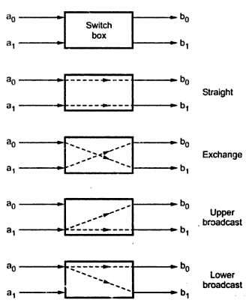
Switch box

Slide 22
Two-sided multistage n/w
Blocking n/w
  Simultaneous connections of more than one terminal pair may result in conflicts in the use of communication links
  Eg: omega, flip, n cube, baseline network
Rearrangeable n/w
  n/w that perform all possible connections b/w inputs & outputs by rearranging its existing connections, so that a connection path for new I/O pair can be established
  Eg : Benes network
Nonblocking n/w
  n/w which can handle all possible connections without blocking
  Eg : Clos network

Slide 23
Baseline Network
0
A
0
A
E
I
1
1
2
C
2
C
G
J
3
3
4
B
4
B
F
K
5
5
6
D
6
D
H
L
7
7

Slide 24
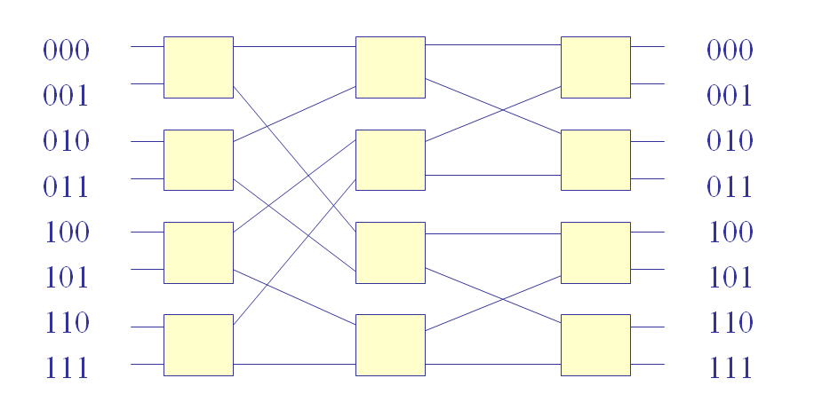
8 * 8 Baseline network

Slide 25
Benes Network
0
0
1
1
2
2
3
3
4
4
5
5
6
6
7
7

Slide 26
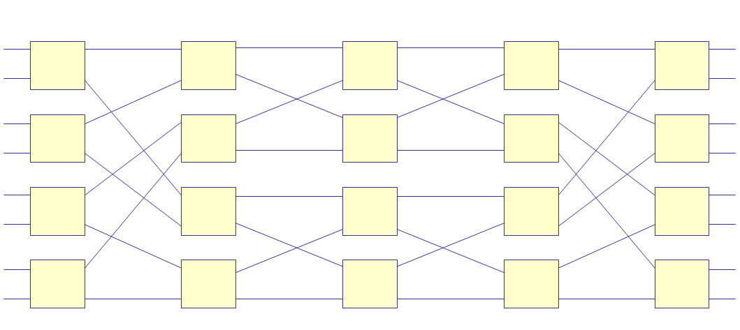
8*8 Benes network

Slide 27
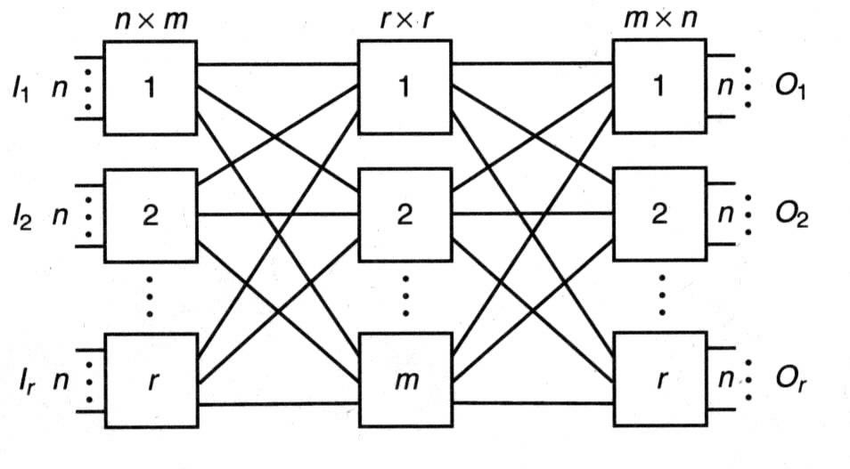
Clos network

Slide 28
A multistage n/w consists of n stages
N=2^{n} , N: no. of I/O lines
Each stage use N/2 switch boxes
Each stage is connected to next stage by at least N paths
Control structure determines how the states of switch boxes will be set
    Individual stage control
    Individual box control
    Individual stage control uses same control signal to set all switch boxes in the same state ie, all boxes set to same state
    Individual box control uses separate control signal to set the state of each switch box, different state

Slide 29
1) Mesh-Connected Illiac Network
Dynamic single stage reconfigurable network
Communication is possible only between the neighboring nodes.
The output of IS is connected to the inputs of OS.
Each PE_{i} is allowed to send data to PE _{i+1},PE _{i-1},PE,_{i+r} PE_{i-r} where r=√N.
    Eg: Illiac IV array processor, N=64 , r= √64=8
    N, is the number of processing elements PE

Slide 30


Slide 31
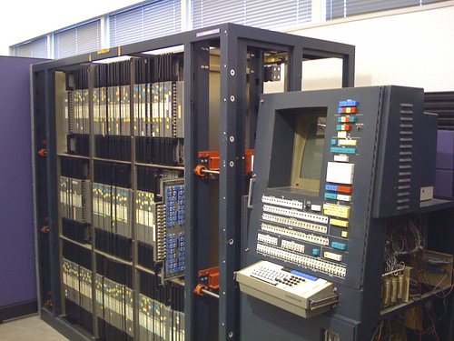

Slide 32
Routing functions..
Formally Illiac network is characterized by following four routing functions.
  R₊₁(i) = (i +1)mod N
  R₋₁(i) = (i -1) mod N
  R_{+r}(i)= (i +r) mod N
  R_{-r}(i)= (i -r) mod N
Outputs of IS_{i} are connected to inputs of OS_{j} for j=i + 1, i – 1, i + r , i – r
OS_{j} gets its inputs from IS_{i} for i= j – 1, j + 1, j – r, j + r

Slide 33
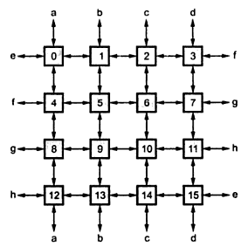
Mesh connections

Slide 34
Each PE_{i} is directly connected to its 4 nearest neighbors in mesh n/w
Permutations for N=16, r=4
  R₊₁=(0 1 2 ……N-1)
  R₋₁=(N-1………2 1 0)
    R₊₄=(0 4 8 12)(1 5 9 13)(2 6 10 14 )(3 7 11 15)
    R₋₄=(12 8 4 0)(13 9 5 1)(14 10 6 2 )(15 11 7 3)
  Eg : consider mesh 5, i =5, r =4,the four neighbor connections are
  6 (5 + 1) : (i + 1)
  4 (5 – 1) : (i – 1)
  9 (5 + 4) : (i + r)
  1 (5 – 4) : (i – r)

Slide 35
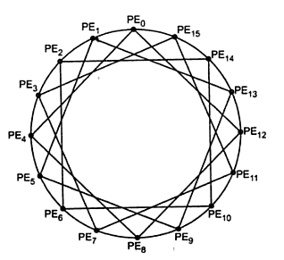
Mesh redrawn

Slide 36
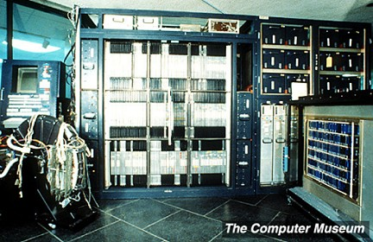

Slide 37
Cube Interconnection Networks
→Recirculating network or multistage network
→Vertical lines connect the vertices PE, whose address differ in MSB.
→Horizontal lines differ in the LSB
→diagonal lines differs in Middle bit
→In the ‘n’ cube, each PE located at a corner is directly connected to n neighbors.

Slide 38
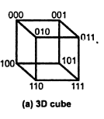
Cube Interconnection Networks

Slide 39
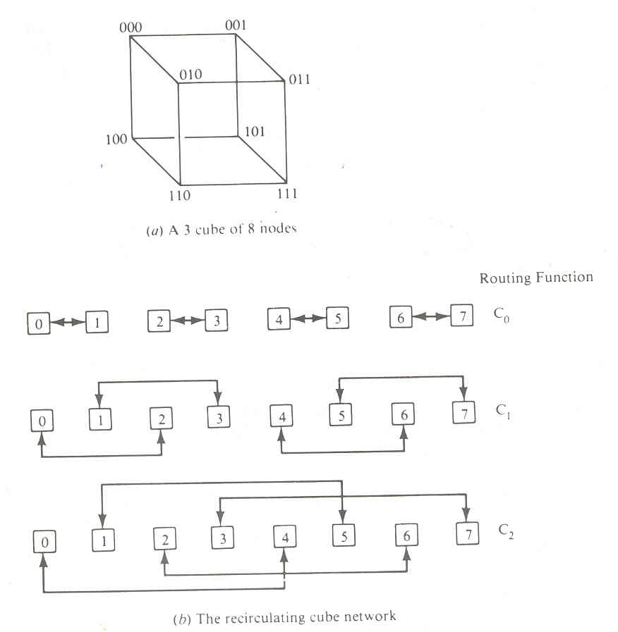

Slide 40
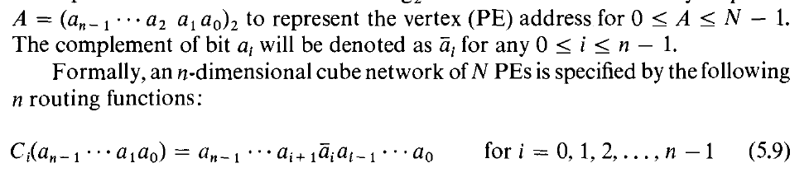

Slide 41
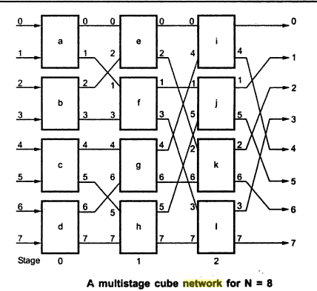


Slide 42
Barrel shifter and Data manipulation
Barrel Shifters are also known as PM2I network
Barrel shifting allows either forward or backward shifting.
Barrel shifter is implemented with multiple stages as a data manipulator.
Data manipulating functions are replicating, permuting, complementing.

Slide 43
Shuffle exchange
Two routing functions: shuffle “S” and Exchange “E”.
→Perfect shuffle: Cuts the decks into two halves from the center and intermixes them evenly
→Inverse perfect shuffle:

Slide 44
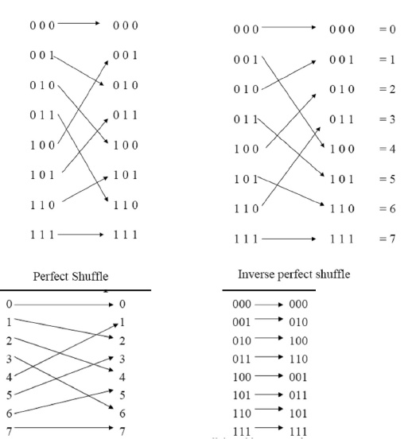

Slide 45
PARALLEL ALGORITHMS FOR ARRAY PROCESSORS
Parallel processing algorithms have been developed by many computer scientists for SIMD computers.
Important SIMD algorithms can be used to perform matrix multiplication, fast Fourier transform (FFT), matrix transposition, summation of vector elements, matrix inversion,
parallel sorting, linear recurrence, boolean matrix operations, and to solve partial differential equations.

Slide 46
SIMD Matrix Multiplication
The differences between SISD and SIMD matrix algorithms are pointed out in their program structures and speed performances.
In general, the inner loop of a multilevel SISD program can be replaced by one or more SIMD vector instructions.
Let A = [a_{ik}] and B = [b_{kj} ]be n x n matrices. The multiplication of A and B generates a product matrix
C = A x B = [C_{ij}] of dimension n x n.

Slide 47

The elements of the product matrix C is related to the elements of A and B by:

Slide 48
There are n³ multiplications carried out with 3 levels of DO loops
Time complexity is proportional to n³

Slide 49
O(n³) algorithm for SISD matrix multiplication
For i = 1 to n Do
  For j = 1 to n Do
Cij = 0 (initialization)
For k = 1 to n Do
    c_{ij}=c_{ij} + a_{ik} . b_{kj} (scalar additive multiply)
  End of k loop
    End of j loop
End of i loop

Slide 50
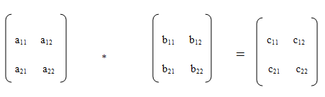
Consider the matrix

Slide 51
c_{ij} = c_{ij} + a_{ik} * b_{kj}
Consider the matrix
i=1 , j=1, k=1, c_{ij} = 0
c₁₁ = c₁₁ + a₁₁ * b₁₁
Next Iteration
k increments
i=1 , j=1, k=2
c₁₁ = c₁₁ + a₁₂ * b₂₁
Thus C₁₁ ₌ a₁₁ * b₁₁ + a₁₂ * b₂₁

Slide 52
End of k loop
Next iteration
i=1, j=2, k=1
c₁₂ = c₁₂ + a₁₁ * b₁₂
k increments
i=1, j=2, k=2
c₁₂ = c₁₂ + a₁₂ * b₂₂
c₁₂ = a₁₁ * b₁₂ + a₁₂ * b₂₂

Slide 53
O(n²) algorithm for SIMD matrix multiplication
For i = I to n Do
Par for k = I to n Do
C_{ik} = 0 (vector load)
For j = I to n Do
Par for k = 1 to n Do
C_{ik} = C_{ik} + a_{ij} . b_{jk} (vector multiply)
End of j loop
End of i loop

Slide 54
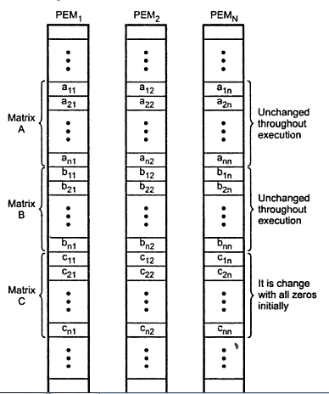


Slide 55
We need to implement matrix multiplication on SIMD computer with n PE’s
The algorithm constructs depends on memory allocations of A, B, C matrices in the PEM’s
Row vectors are stored in the same PEM, column vectors are stored in another PEM
This memory allocation scheme allows parallel access of all elements in each row vector of matrices
Based on this, we obtain the parallel algorithm for SIMD

Slide 56
The 2 parallel DO’s corresponds to
vector load for initialization & vector multiply for additive multiplications
Time complexity has been reduced to O( _{n}² )
Vector load is performed to initialize row vectors of matrix C
Vector multiply,
the same multiplier a_{ij} is broadcast from CU’s to all PE’s to multiply all n elements (b_{ik} for k = 1,2…n )
In total , _{n}² vector multiply operations are performed

Slide 57
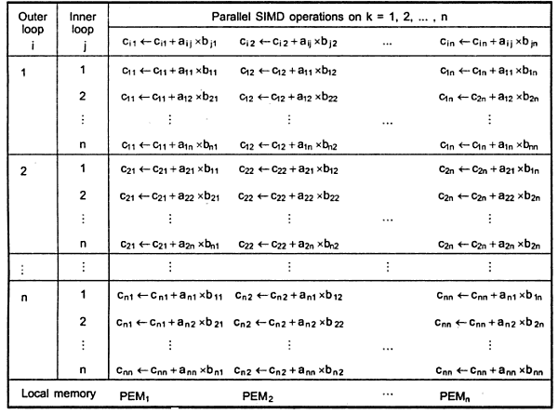

Slide 58
An O(n log2 n) algorithm for SIMD matrix multiplication
If we increase the number of PEs used in an array processor to n² an O(n log₂n) can be devised to multiply two n x n matrices a and b.
Let n=2^{m}.
Consider an array processor whose n² =2^{2m}
PEs are located at the 2^{2m} vertices of a 2m cube network.

Slide 59
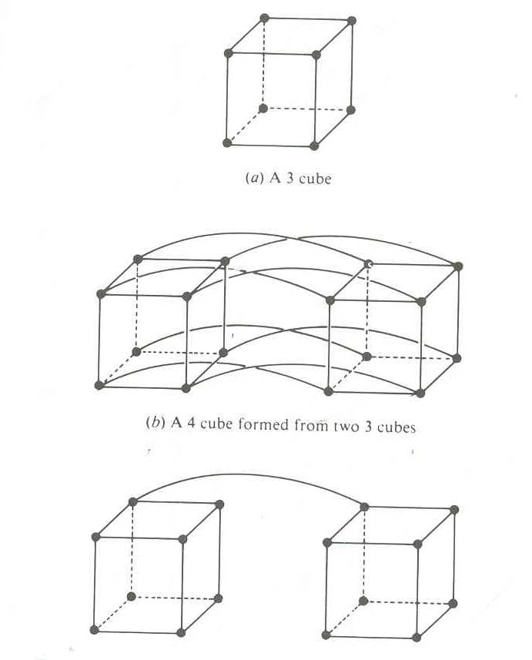
In Figure 4-cube network is constructed from two 3-cube networks by using 8 extra edges between corresponding vertices at the corner positions.

Slide 60
Let (P_{2m-l} P_{2m-2}... P_{m} P_{m-l}. .,P_{I} P_{O})2) be the PE address in the 2m cube.
We can achieve the O(n log2 n) compute time only if initially the matrix elements are favorably distributed in the PE vertices.

Slide 61
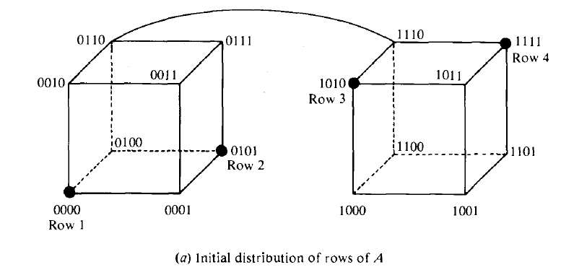
The n rows of matrix A are distributed over n distinct PEs whose addresses satisfy the condition
P2m-l P2m-2...Pm =Pm-l Pm-2.....p0.

Slide 62
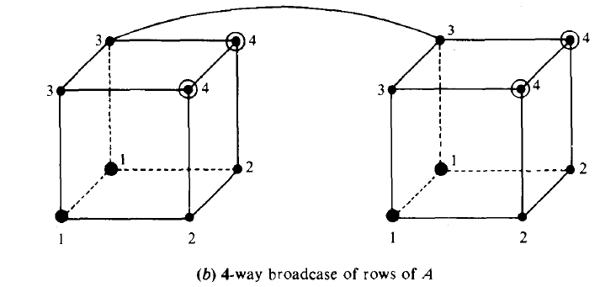
The four rows of A are then broadcast over the fourth dimension and front to back edges, as marked by row numbers in Figure

Slide 63
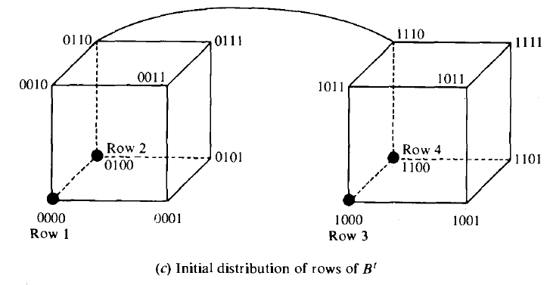
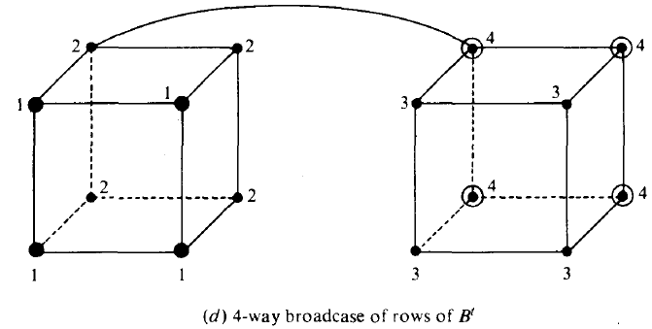
The n columns of matrix B (or the n rows of matrix B') are evenly distributed over the PEs of the 2m cubes
The four rows of B' are then broadcast over the front and back faces

Slide 64
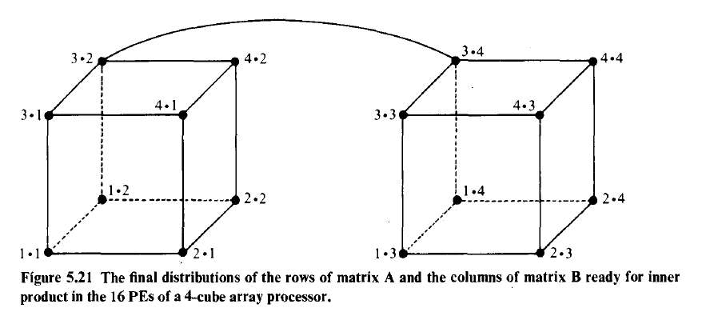
the combined results of A and B' broadcasts with the inner product ready to be computed.

Slide 65
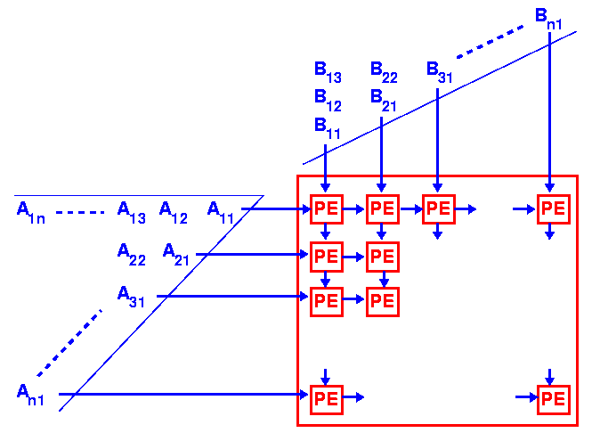
SIMD
Note the B matrix
is transposed!
Matrix multiplication
  Each PE
    * then
    +
  PE_{ij} ⇨ C_{ij}

Slide 66
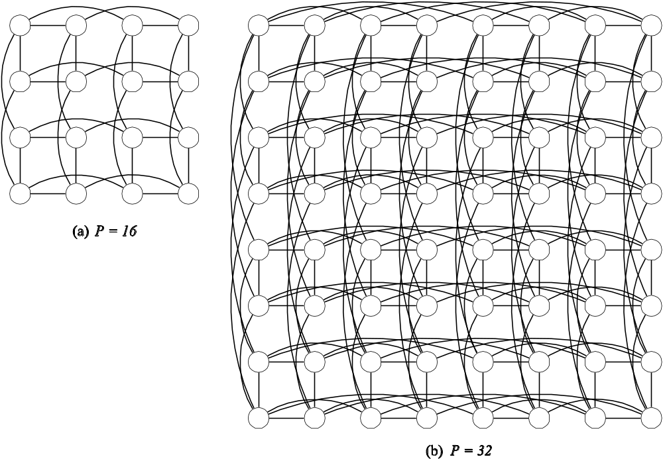
Embedding Hypercube

Slide 67
The matrix multiplication on a 2m-cube network is formally specified below
1.Transpose B to form B^{t over the m cubes x}_{2m-1}…………………._{Xm}0…..0.
2.N-way broadcast each row of B^{t}to all PEs in the m cube.
3.N-way broadcast each row of A
4.Each PE now contain a row of A and a column of B.
The above algorithm have O(n log2 n)

Slide 68
Parallel Sorting on Array Processors
An SIMD algorithm is to be presented for sorting n² elements on a mesh-connected (llIiac-lV-Iike) processor array in O(n) routing and comparison steps.
2 time measures are needed to estimate the complexity of parallel sorting algorithm
t_{R} -> routing time required to move one item from a PE to a neighbour
t_{c} -> comparison time required for one comparison
Upto N comparisons can be performed simultaneously

Slide 69
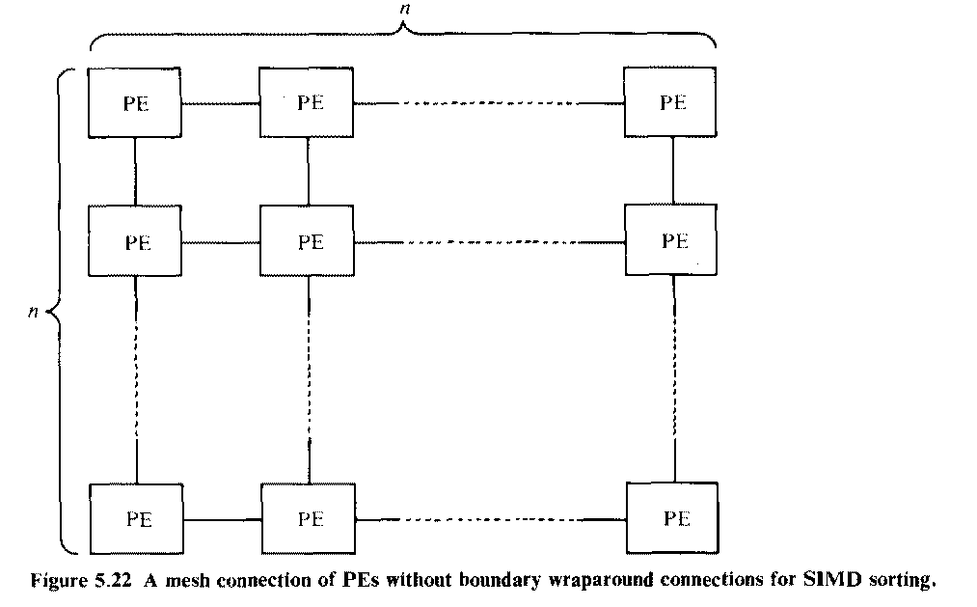

Slide 70
Comparison-Interchange step b/w 2 adjacent PE’s can be done in 2 t_{R} + t_{c} time units (route left, compare, route right)
Sorting problem depends on the indexing schemes on PE’s
3 indexing patterns are formed after sorting a given array

Slide 71
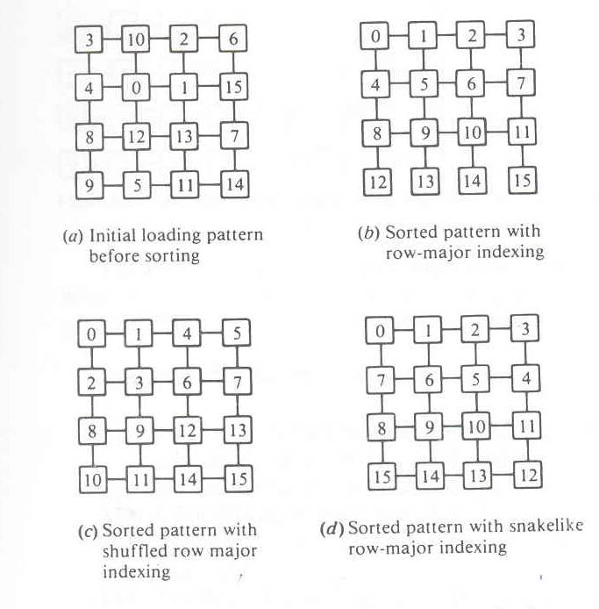

Slide 72
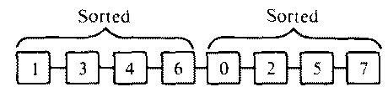
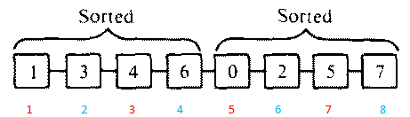
Batcher’s odd-even merge sort algorithm
L1:Odd elements are moved to left side & even elements to other
L2:again move odds to left & evens to right
(1, 4, 0, 5) are odd positioned elements (red) & (3, 6, 2, 7) are even positioned elements (Blue)

Slide 73
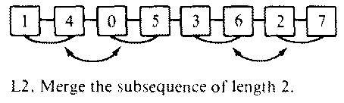

Slide 74
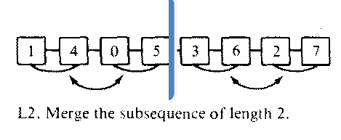

Sort both sides ( separated by blue line)

Slide 75
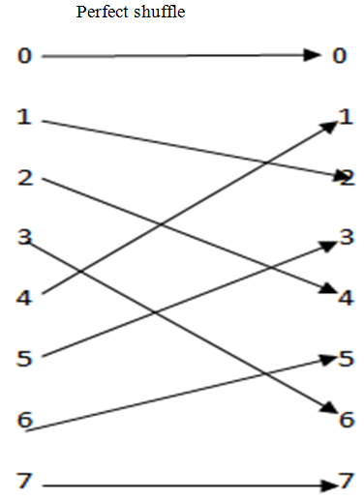


L3 : Perfect Shuffle

Slide 76
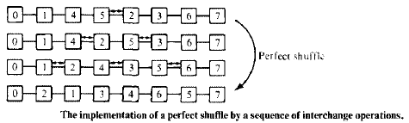
Steps of perfect shuffle :-

Slide 77
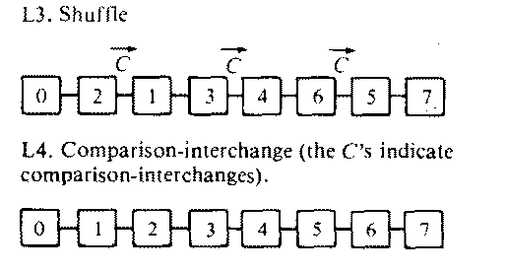
Shuffle & unshuffle operations can be implemented with a sequence of interchange operations

Slide 78
Batcher’s odd-even merge sort on a linear array has been generalized by Thompson to a square array of PE’s
Let M (j , k) be a sorting algorithm for merging 2 sorted arrays to form a j by k array
Given M (j, 2) algorithm :-

Slide 79
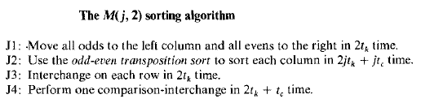

Slide 80
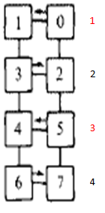
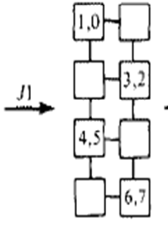
J1 : move all odd positioned elements to left &
even positioned elements to right

Slide 81

J2 : Odd-even transposition sort

Slide 82


J3 : Interchange on each row
To get snake like sort index pattern, (1,3) & (5,7) should perform interchange

Slide 83

J4 : Comparison- Interchange

Slide 84

M(4,2) sorting algorithm

Slide 85
ASSOCIATIVE ARRAY PROCESSING

Slide 86
ASSOCIATIVE ARRAY PROCESSING
2 SIMD computers, STARAN & PEPE (Parallel Element Processing Ensemble) have been built around an Associative Memory (AM) instead of conventional RAM
AM is content-addressable, allowing parallel access of multiple memory words
RAM must be sequentially accessed by specifying the word addresses

Slide 87
ASSOCIATIVE MEMORY ORGANISATION
Main advantage of AM over RAM is its capability of performing parallel search & parallel comparison
Main applications are storage & retrieval of rapidly changing databases, image processing, artificial intelligence etc
Major shortcoming is its increased h/w cost, cost of AM is much higher than that of RAM’s

Slide 88

Structure of basic AM

Slide 89
AM array consists of n words with m bits per word
A bit-slice is a vertical column of bit cells of all words at the same position
B_{ij} -> jth bit cell of ith word
ith word is denoted as
    W_{i} = (B_{i1} B_{i2……} B_{in} ) i = 1,2….n
jth bit slice is denoted as
    B_{j} = (B_{1j} B_{2j} ….. B_{nj} ) j = 1, 2….n

Slide 90
Parallel search operations involve both comparison & masking , are executed a/c to the organization of AM
Comparand register C = (C₁ , C₂ , …. C_{m} ) is used to hold the key operand being searched for or being compared with.
Masking register M = (M₁ , M₂ , …. M_{m} ) is used to enable or disable the bit slices to be involved in parallel comparison operations
Indicator register I = (I₁ , I₂ , …. I_{n} ) and one or more temporary registers T = (T₁ , T₂ , …. T_{n} ) are used to hold current & previous match patterns

Slide 91
Search key in the C register is first masked by the bit pattern in the M register
Parallel comparisons of masked key word with all words in the AM are performed
All the involved bit slices are compared in parallel or in sequential order, depending on AM memory organization
Its possible that multiple words in the AM will match the search pattern, thus AM will tag all the matched words
( Indicator & Temporary registers are used for this purpose)

Slide 92
Associative Memory Organizations
Based on how bit slices are involved in the operation, there are 2 different memory organizations
        Bit Parallel organization
        Bit Serial Organization

Slide 93



Slide 94
Bit Parallel Organization
Bit Serial Organization
Comparison process is performed in a parallel-by-word & parallel-by-bit fashion
All bit slices which are not masked off by the masking pattern are involved in comparison process
Word-match tags for all words are used
Requires additional word-match detection logic
Fast in speed
Operates with one bit slice at a time across all words
Particular bit slice is selected by an extra logic & control unit
Requires less h/w
Slow in speed

Slide 95
Consider an eg. student file search in a bit-parallel organization (fig)
Query -> search students whose age is not younger than 21 but is younger than 31
perform not less than search & less than search
Masking pattern selects age field
Lower-bound 21 is loaded into C register as the first key word
Parallel comparisons are performed on all student records

Slide 96
After first search, students who are not younger than 21 are marked with a 1 in the indicator register
This matching vector is then transferred to one of the T registers
Then upper-bound 31 is loaded into C as the second matching key
After second search, new matching vector is sent to Indicator register
A bitwise AND is performed b/w I and T registers
Final o/p is stored in I register

Slide 97


Slide 98


I register
T register
After ^{1st} search
(>21)
Copied to
T register

Slide 99

2nd search -> upper bound 31
I register
After 2nd search
(< 31)

Slide 100

Perform bitwise AND b/w I and T registers
I register Result I register
T register
T & I

Slide 101
Thus the search is completed , answer set for the query are { 25, 28, 21, 31} whose positions are marked as 1’s, others are marked as 0’s.
T & I

